Slide 1

RAGHU ENGINEERING COLLEGE
(AUTONOMOUS)
DEPARTMENT OF EEE
Academic year: 2018-2019
II year 2-semister
Digital Electronics
CASE STUDY
ON
TO DESIGN THE CIRCUIT FOR THE EXPRESSION Y=A’B+C’D AND DO THE DELAY ANALYSIS IN ALL POSSIBLE REALISATIONS.
FACULTY:
Mr.D.Bhaskar Rao
Associate professor
BATCH-10
18985A0246 – K.Karthik
18985A0247 – L.Ratnakara Rao
18985A0248 – M.Gaddim Naidu
18985A0249 – M.Jagapathi varma
18985A0250 – M.Sai

Slide 2
Design Task
Case study on design the circuit for expression Y =A’B + C’D and do the delay analysis in all possible realisation

Slide 3
Design Restriction
4 bits are majority
Design Goal
To design a circuit which as delay time by examining possible realizations.

Slide 4
Design options:
We can do this by 4 realizations namely:
SOP Realization.
POS Realization.
NAND Realization.
NOR Realization.

Slide 5
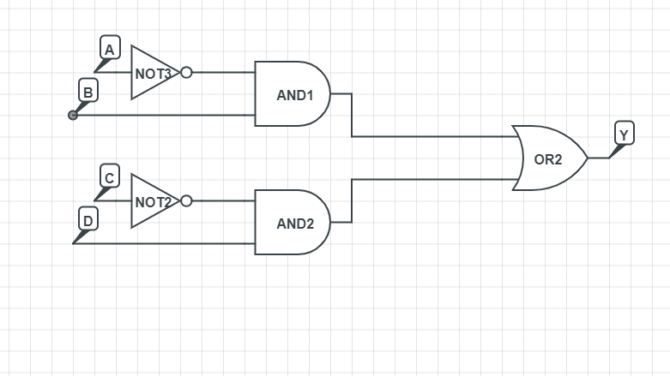
Circuit Diagram
The circuit diagram of given expression :
Expression : A’B +C’D

Slide 6
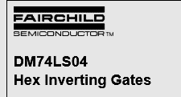

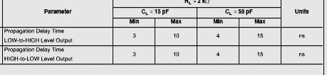






NOT Gate- 74ls04
OR Gate- 74ls32
AND Gate- 74ls08

Slide 7
DELAY ANALYSIS FOR SOP REALISATION
S.NO | PATH | TWO INPUT NOT | TWO INPUT AND | TWO INPUT OR | DELAY TIME In (nanosec) | TOTAL DELAY In (nanosec) | MAXIMUM DELAY In (nanosec)
1 | A-Y | 1 | 1 | 1 | 15+18+15 | 48 | 48
2 | B-Y | - |  |  | 18+15 | 33
3 | C-Y | 1 | 1 |  | 15+18+15 | 48
4 | D-Y | - |  |  | 18+15 | 33

Slide 8
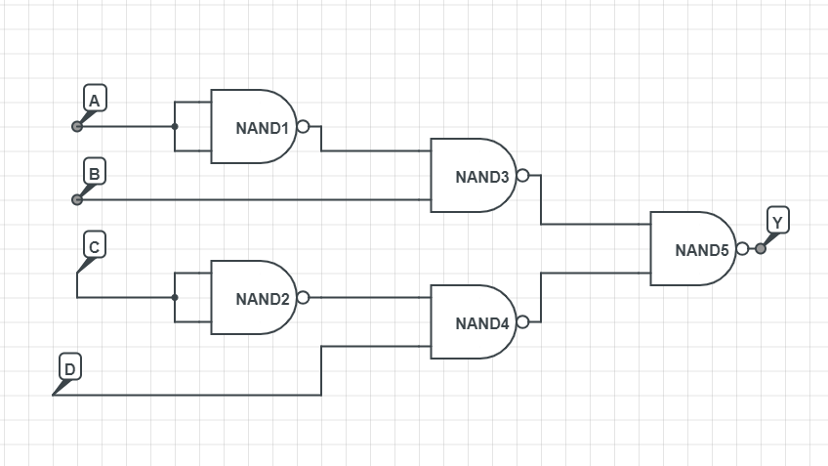
Nand Realisation

Slide 9







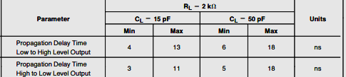
2 input NAND Gate-74ls00

Slide 10
DELAY ANALYSIS FOR NAND REALISATION
S.NO | PATH | TWO INPUT NAND | DELAY TIME | TOTAL DELAY | MAXIMUM DELAY
1 | A-Y | 3 | 3*15 | 45 | 45
2 | B-Y | 2 | 2*15 | 30
3 | C-Y | 3 | 3*15 | 45
4 | D-Y | 2 | 2*15 | 30

Slide 11
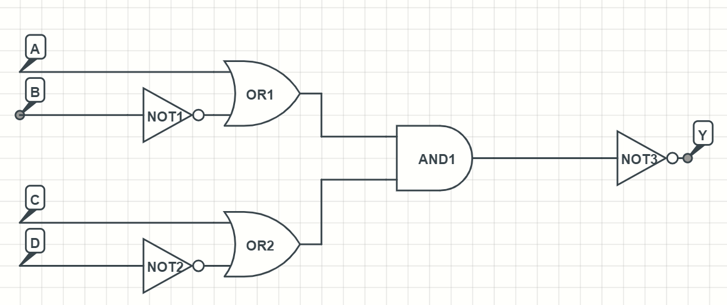
POS Realisation
Expression : (A+B’).(C+D’)

Slide 12
NOT Gate- 74ls04
OR Gate- 74ls32
AND Gate- 74ls08

Slide 13
DELAY ANALYSIS FOR POS REALISATION
S.NO | PATH | TWO INPUT NOT | TWO INPUT AND | TWO INPUTOR | TIME DELAY | TOTAL DELAY | MAXIMUM DELAY
1 | A-Y | 1 | 1 | 1 | 18+15+15 | 48 | 63
2 | B-Y | 2 | 1 | 1 | 15*2+18+15 | 63
3 | C-Y | 1 | 1 | 1 | 18+15+15 | 48
4 | D-Y | 2 | 1 | 1 | 15*2+18+15 | 63

Slide 14
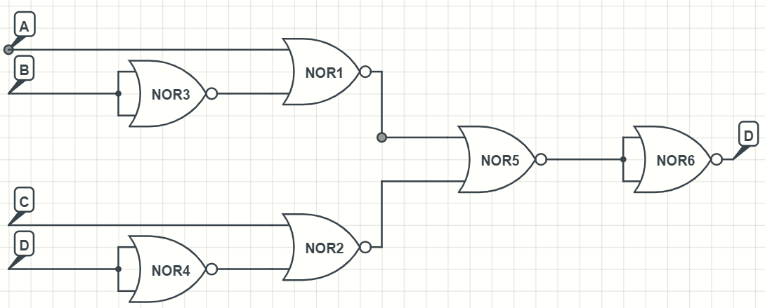
NOR Realisation

Slide 15
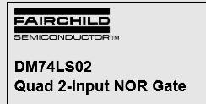
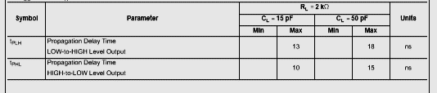




2 input NOR Gate- 74ls02

Slide 16
DELAY ANALYSIS NOR REALISATION
S.NO | PATH | TWO INPUTOR | TIME DELAY | TOTAL DELAY | MAXIMUM DELAY
1 | A-Y | 3 | 3*15 | 45 | 60
2 | B-Y | 4 | 4*15 | 60
3 | C-Y | 3 | 3*15 | 45
4 | D-Y | 4 | 4*15 | 60

Slide 17
DELAY TIME EFFECTIVE REALISATION
S.NO | TYPE OF REALISATION | MAXIMUM DELAY IN NANO SEC
1 | SOP | 48
2 | NAND | 45
3 | POS | 63
4 | NOR | 60
We hereby conclude that NAND circuit is delay effective, whereas POS comes under the worst case i.e., with more delay.

Slide 18
DESIGN FAILURE ANALYSIS
TYPE OF REALIZATION | NO. OF IC’s USED | HIGHEST PROBABILITY OF FAILURE
SOP | 3 | 2
POS | 3
NAND | 2
NOR | 2
As the no. of IC’s used in NOR realization are 2, there is a less probability of occurrence of failure.

Slide 19
CONCLUSION
All the realizations have been designed and verified using circuit lab software, and we conclude that NAND realization provides less delay when compared to all other realizations.

Slide 20
REFERECE FOR DELAY TIME IS TAKEN FROM:
FAIR CHILD SEMICONDUCTOR
MOTOROLA .
GLOBAL ELECTRONICS.
ON SEMICONDUCTOR.
TOSHIBA.
PHILIPS

